Slide 1
WEEK 2 | Network Traffic & Windows Logging
• DG Interns Hub — Cybersecurity Internship
• Wireshark • Nmap • Windows Event Viewer • PowerShell
• Reporting deadline: 30 October 2026
Kesheth Swarnachandran

Slide 2
Objectives & Lab
• Read TCP handshakes, HTTP, DNS and ICMP packet traces
• Understand Nmap scan behaviour and outputs
• Investigate Windows Security events and logon types
• Lab: Kali .102 | Ubuntu .101 | Windows 11 .104 (192.168.56.0/24)

Slide 3
Learning Deliverables
• 8 separate theory notes
• 6 TryHackMe rooms, each with a writeup and completion screenshot
• 1 Wireshark practical writeup
• 2 cheat sheets: 20 Wireshark filters and 15 Windows Event IDs

Slide 4
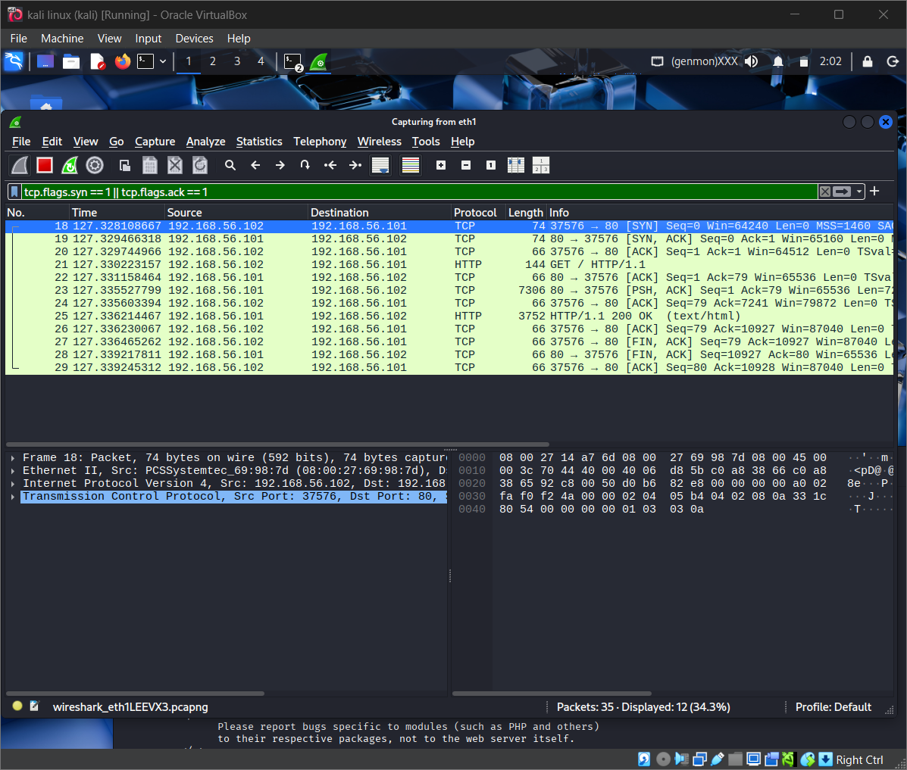
Wireshark | TCP Handshake

Slide 5
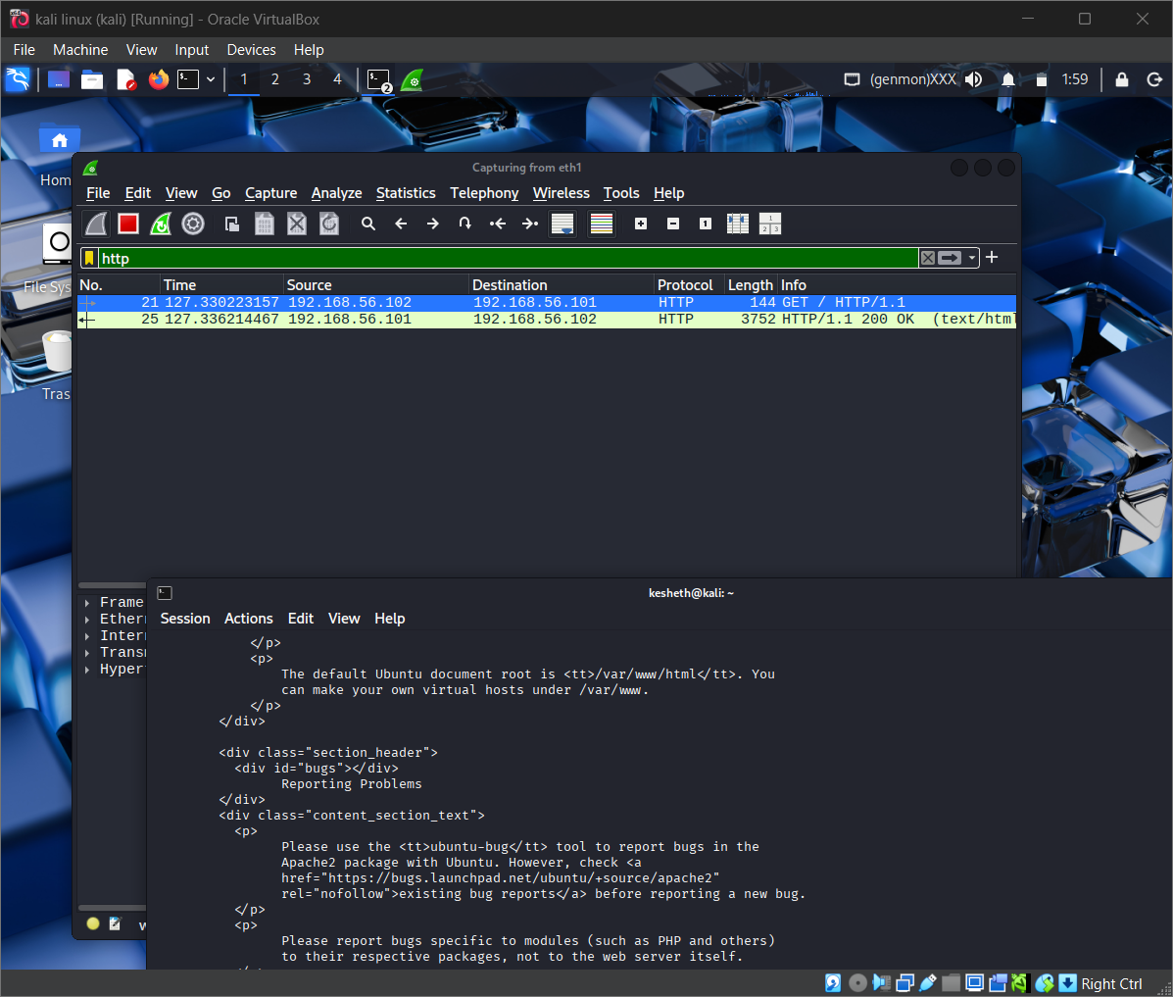
Wireshark | HTTP GET

Slide 6
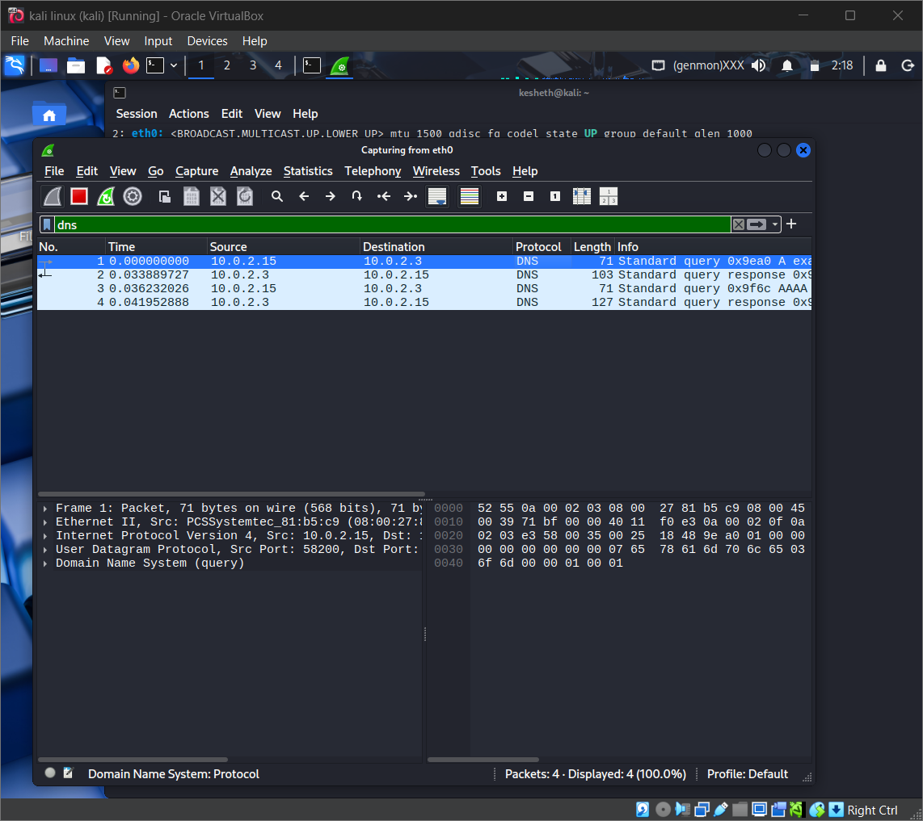
Wireshark | DNS Query

Slide 7
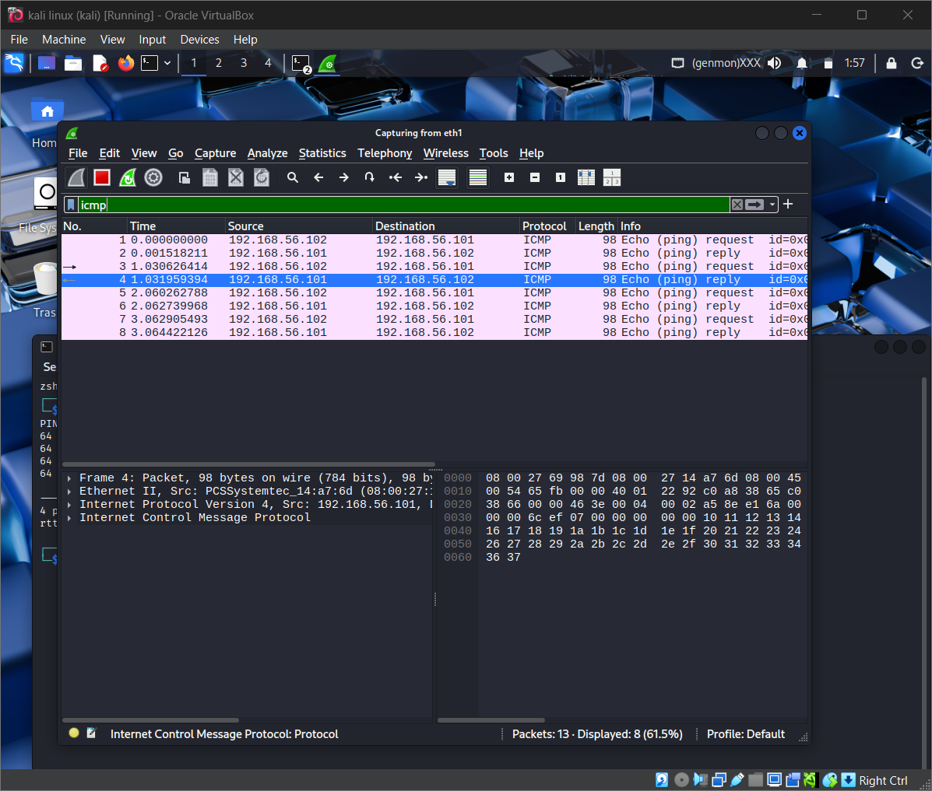
Wireshark | ICMP Echo

Slide 8
Nmap | Lab Results
• Ubuntu 192.168.56.101: TCP/80 open (HTTP); 999 TCP ports closed in SYN scan
• Windows 192.168.56.104: all 1,000 tested TCP ports filtered in SYN scan
• 5 scan types per target: -sn, -sS, -sV, -O, -A
• 20 scan files: 10 TXT + 10 XML; SYN/RST packet capture retained

Slide 9
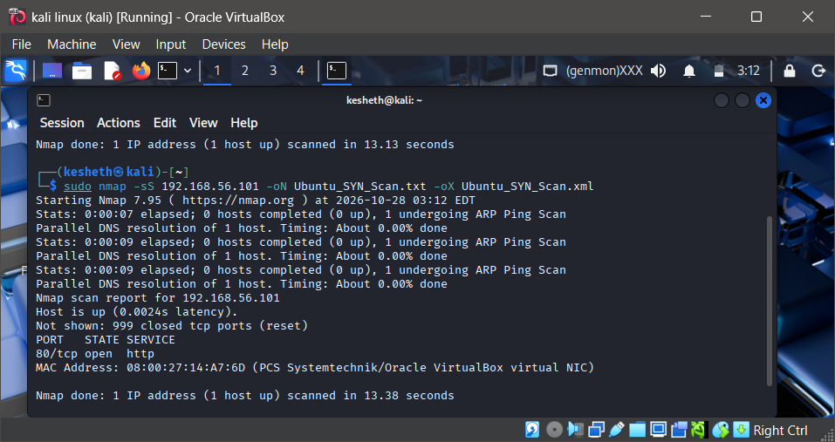
Nmap | SYN Scan Evidence

Slide 10
Windows | Event Viewer
• 4625 failed logon; 4624 successful logon (observed type 5: service)
• 4720 new user; 4732 group membership change
• 7045 dummy service installed (System log)
• 1102 Security log cleared; EVTX backup saved first

Slide 11
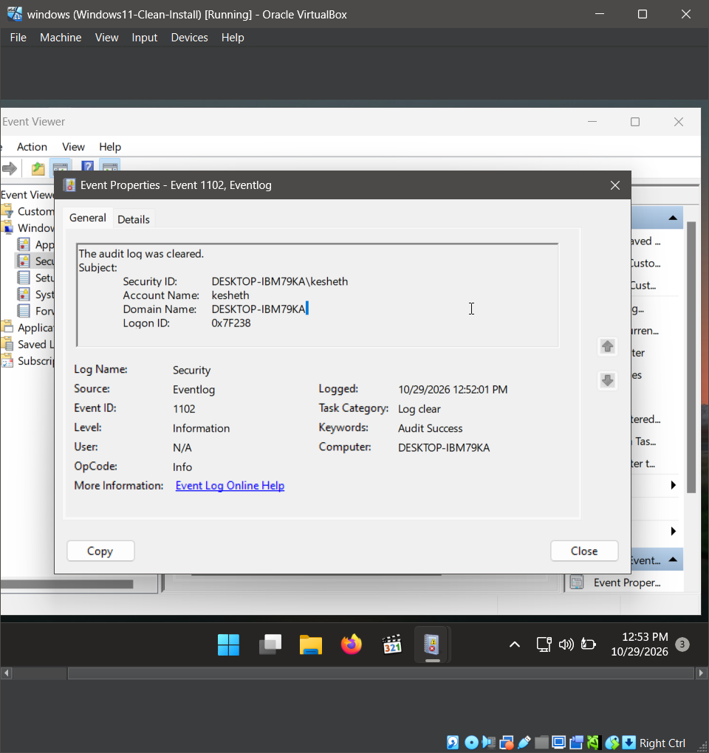
Windows | Event 1102

Slide 12
PowerShell | Failed Logons
• Get-WinEvent -FilterHashtable queried saved EVTX for Event ID 4625
• Three failed logon events exported to CSV
• Group-Object counted three failed attempts for account kesheth
• Controlled lab activity — not proof of an attack

Slide 13
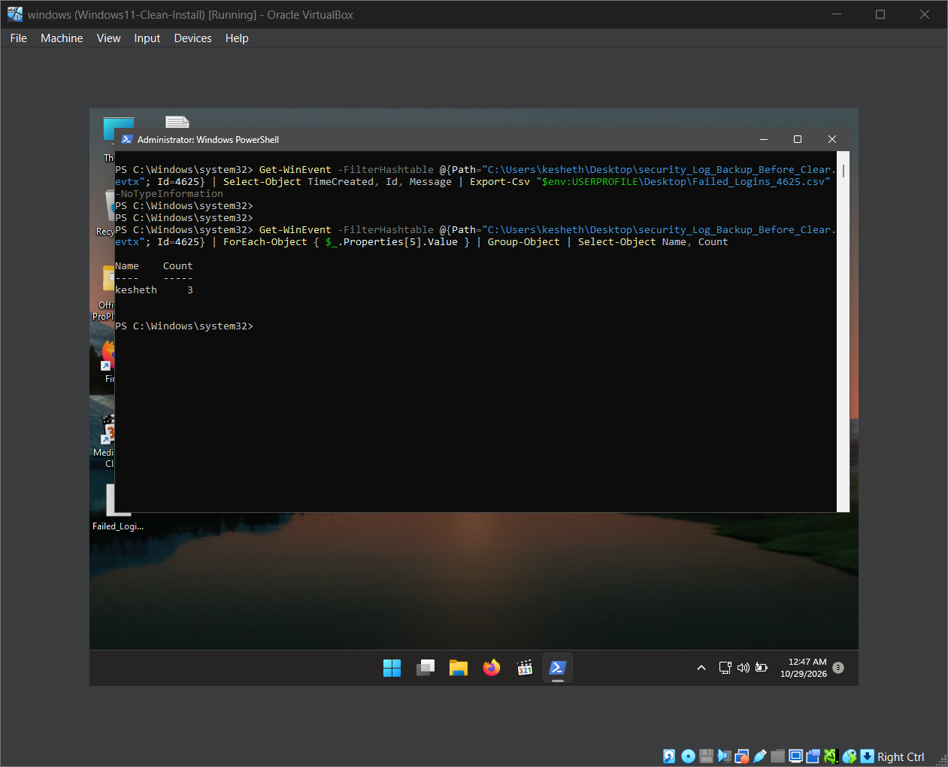
PowerShell | Evidence

Slide 14
SOC Takeaways & Next Steps
• Packet and endpoint baselines help distinguish expected from unusual behaviour
• A filtered port is not the same as a closed port
• Preserve logs before clearing; retain evidence with screenshots and exports
• Next: Week 3 IDS and endpoint monitoring
• LinkedIn publication and Drive submission require separate confirmation
Kesheth Swarnachandran

